Slide 1
BSLL PARENTS MEETING 2023
APRIL RICE- PRESIDENT

Slide 2
Beaumont Softball City Little League is a non-profit organization whose mission is to “promote, develop, supervise, and voluntarily assist in all lawful ways, the interest of those who will participate in Little League Softball.” ﻿
Beaumont Softball Little League was established in January 2015 but has been a part of the community for many years prior. We established bridging two communities of Softball Players from Hollywood Rose City and Wilshire Riverside Little Leagues (adding Parkside Softball Players a couple years later). We are here for Softball Players and its community. Promoting girls to become young women who are well rounded, independent- leaders, and who are superior citizens in the community. Through proper guidance and exemplary leadership, the Little League program assists children in developing the qualities of citizenship, discipline, teamwork and physical well-being. By espousing the virtues of character, courage and loyalty, the Little League Softball program is designed to develop superior citizens rather than superior athletes. We do it for the kids!

Slide 3
BSLL BOARD
Kim Knox- Treasure and WRLL Liaison
Jon Coney- Umpire in Chief
Melissa Schellinkhout- Sponsorship Coordinator
Steve Callas- Field Maintenance
Gretchen Dunn- Equipment Manager
Tracy Bowles- Marketing Coordinator (HRCLL Liasion)
Doug Oberman- Parkside Liaison
Sarah Brown - Website Manager
Christina Gladwin – Uniform Coordinator

Slide 4
WELCOME
New Board Members
Amanda Bickle-Chavez - Sponsorship Coordinator
Cullen Drain- Field Maintenance
John Naekel- Equipment Manager
Missy Phillipi - Player Agent/Registrar
Sherrie Burrell- Secretary

Slide 5
Teams and Players
214 players
T-ball 2 teams
Farm Coach Pitch 2 teams
Farm Player Pitch 5 teams
Minors 5 teams
Majors 3 teams
Juniors 1 teams (Combined BSLL and NPLL)

Slide 6
UMPIRES
& NEW RULES- Little League Rule Book App
Jconey@comcast.net

Slide 7
Practices begin T-ball and Farm 1-2 practices a week Minors, Majors and Juniors 2 practices a week Games begin 4/8 T-ball and Farm 1-2 Games Minors 2 games Majors and Juniors 2-3 games (Some Double Headers on Saturday)
Minors and Majors- 1 Tournament

Slide 8
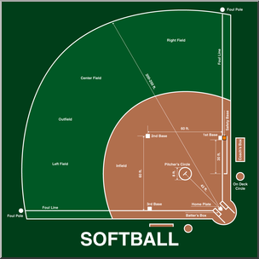
Home Fields Rose City Park- Game (some practices) Irving Park- Practices
Roseway Heights- Practices (Farm only) Games eventually Glenhaven- Practices
Grant High School Turf- Games (some Practices) Erv Lind- Games (Limited)
Away Fields Columbia Annex- NPLL D2 Will be posted once schedule is finalized *All Field Locations posted on website under About Us- Locations

Slide 9
Teams- Catcher's gear and balls Players- Glove, Bat, Helmet, fielding mask, and Cleats (soccer cleats acceptable) Borrow Bats & Helmets from the league Sunday, March 19th 10:00-11:30 Roseway Heights
Equipment

Slide 10
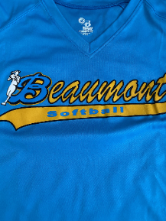
Uniforms Included Jersey (upper levels) Shirt (Farm/T-ball) Socks Visor (only new players)
Uniforms Not Included Black Pants
(T-ball/Farm/Minors)
Grey/Charcoal Pants (Majors/Juniors)
Swag Sweatshirts ,Under Armor, Pants, Belts, Hats, Socks and More…
Online ordering available!
Visit beaumontsoftball.square.site

Slide 11
COVID- 19/Sick Protocols
Masks are not required but optional
Exposure or Symptoms stay home (10 days)
If player is sick of any kind STAY HOME
No shared equipment
Clean and sanitize
Every practice or game day complete your own symptom check

Slide 12
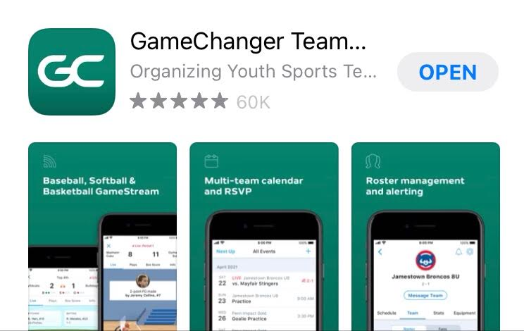
TEAM MANAGER APP

Slide 13
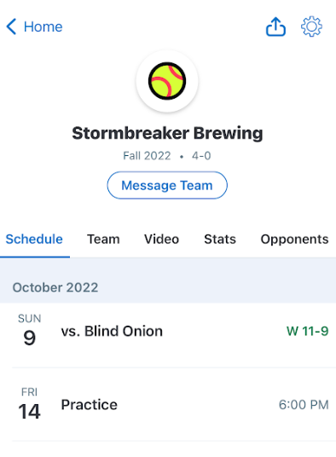
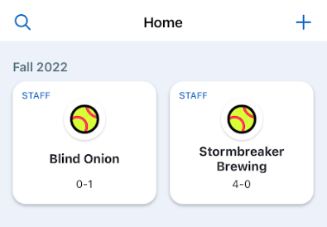
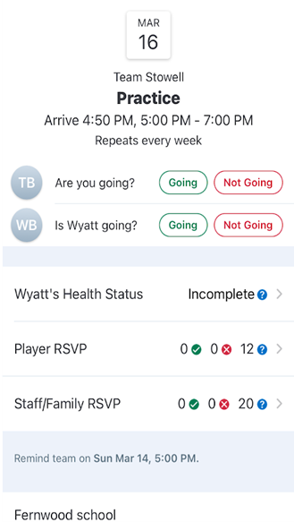
TEAM MANAGER APP

Slide 14
Spectators- etiquette and expectations
Spectators can only be in spectator area
Adhere to rules at each league's fields
No smoking (of any kind), drinking, profanity, or aggressive behavior
Spectators are to support and cheer, or keep quiet
Leave coaching to the coaches
Leave umpiring to the umpires
Leave playing to the players
Sit, back, relax and enjoy the game!

Slide 15
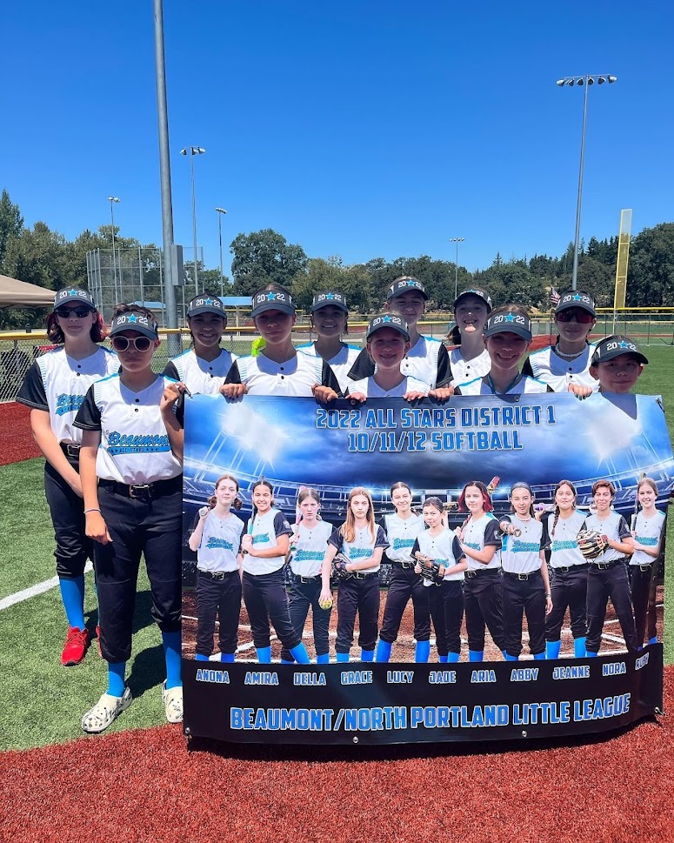
ALL STARS
Post season June- July (Aug)
Competitive
FUN!!!

Slide 16
Major State All Star Tournament
BSLL hosting Majors State All Star Tournament
July 5- 10 at Erv Lind Stadium
Volunteers needed
Field Maintenance
Concessions-
Teams or groups who want to work can take home proceeds
Announcers
Scoreboard

Slide 17
Board Members Needed
President- Manage the league- Shadow now, take over in 2024
VP of Softball – assisting President, clinics,coaches and potentially taking over President.
Scheduler- game and practice scheduler.
Player Agent/Registrar– assist with registration and skill evals, drafting teams, pool players, and All-Star paperwork (2nd person)
Social Media Manager - manages instagram and facebook
Uniform/Swag Coordinator - Future (2024)

Slide 18
Sponsors

Slide 19
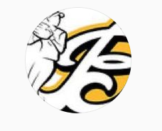
Facebook & Instagram
www.Beaumontsoftball.org

Slide 20
Upcoming Events
Sunday, March 19th 10:00-11:30 Equipment exchange- Roseway Heights
Tuesday, March 21st Scorekeepers Clinic- Roseway Heights (7334 NE Siskiyou)
Friday, April 7th Opening Ceremonies- Erv Lind Stadium
Saturday, April 8th Games Begin!
Majors All Star State Tournament- July 5-10 at Erv Lind Stadium
Visit the our website get all the details
www.Beaumontsoftball.org

Slide 21
Q&A

